Slide 1
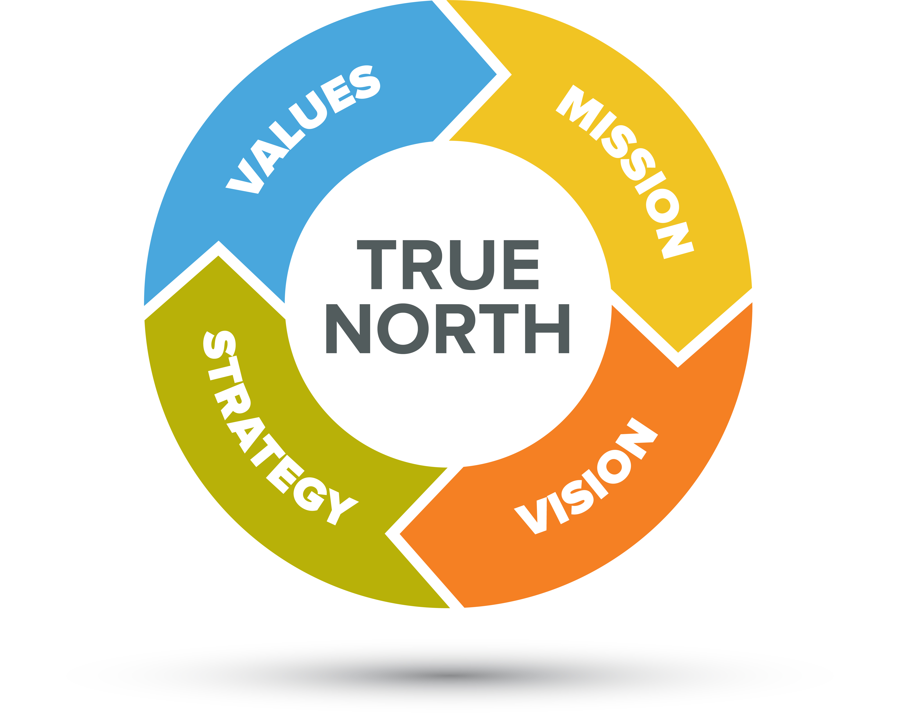
Our Mission
What is our Mission?
Why do we exist? What do we do better than others?
Who is our beneficiary? This is typically not “inside” the church. Who can we reach or serve better then others in our local community?
What is our objective or desired result? What difference would we like to see in 5 or 10 years?
State the mission. This could be a series of short phrases
Does it help us say no to good things? Help making the “hard” decision on how our resources will be used (volunteers, dollars, time, etc.)
TASK:
Develop our mission, keeping in mind the core values we identified in the last session.
Notes:
Examples of Good Mission Statements:
Starbucks: To inspire and nurture the human spirit – one person, one cup and one neighborhood at a time
Amazon: To be Earth’s most customer-centric company where people can find and discover anything they want to buy online.
Walmart: We help people save money so they can live better.
Preliminary Core Value Summary list:
Welcoming
Community Service/generosity
Freely Accepting
Youth Support
Spiritual Accessibility/Variety
Openness
Willingness to change/evolve

